Slide 1

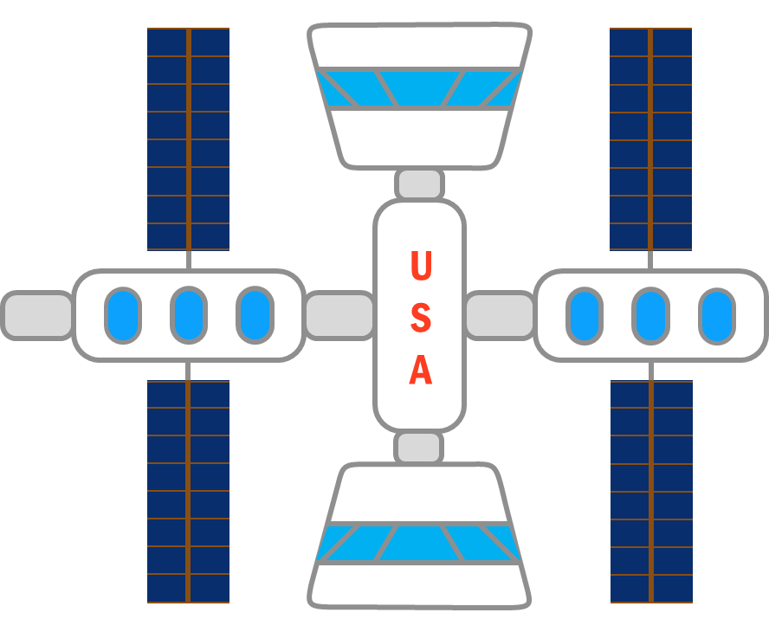
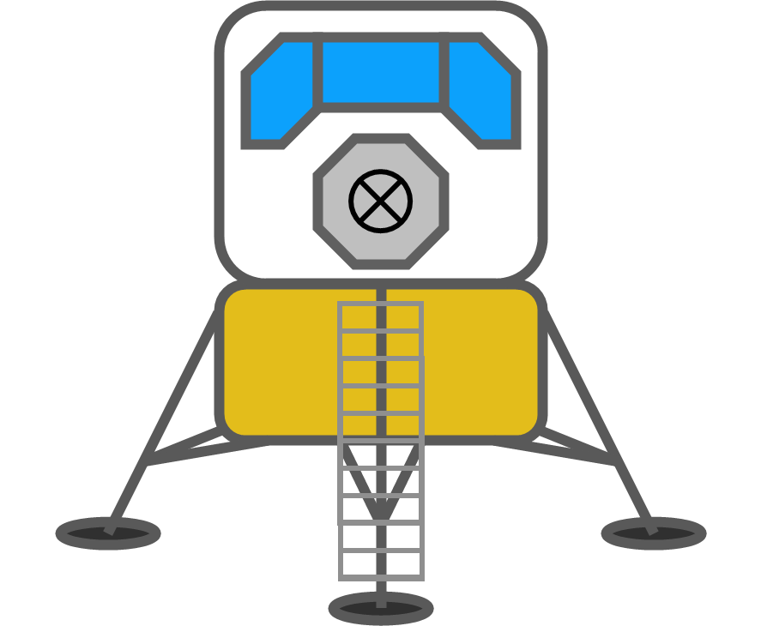
Reusable Shock Absorber
for New Lunar Lander
Design Review 6
Team 515
March 25, 2021
1
Notes:
Arrival: 5:15 PM
Depart: 6:55 PM

Slide 2


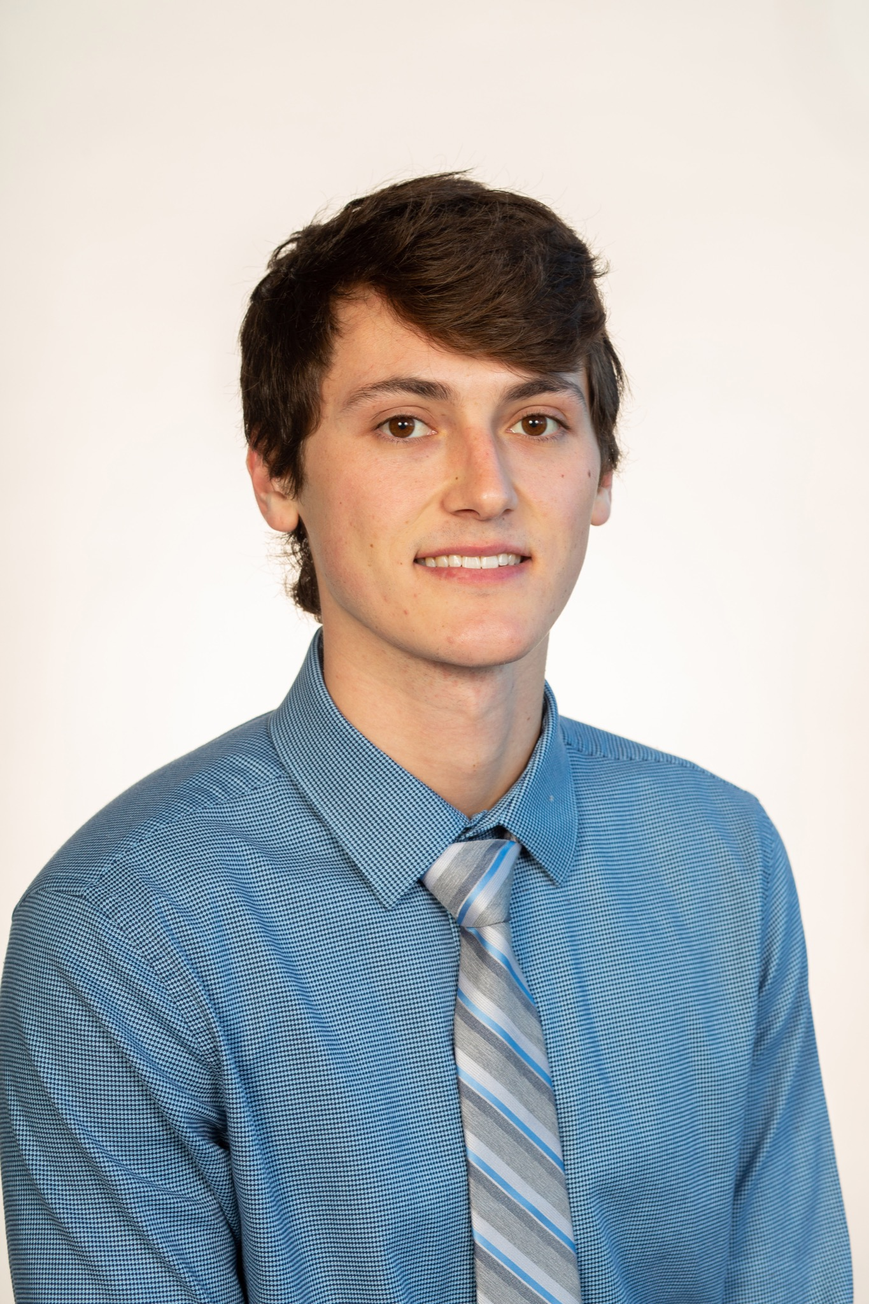


Team Members
Team Members
Josh Blank
Design Engineer
Matt Fowler
Systems Engineer
Tristan Jenkins
Design Engineer
Alex Noll
Mechanical Engineer
Melanie Porter
Dynamics Engineer
Matt Fowler
2

Slide 3

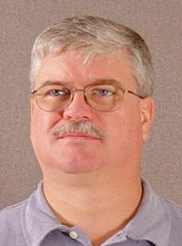



Sponsor & Advisor
Sponsor & Advisor
Project Sponsor
Rachel McCauley
MSFC Advanced Concepts Deputy Manager at NASA
Academic Advisor
Keith Larson
Teaching Faculty I
Matt Fowler

Slide 4

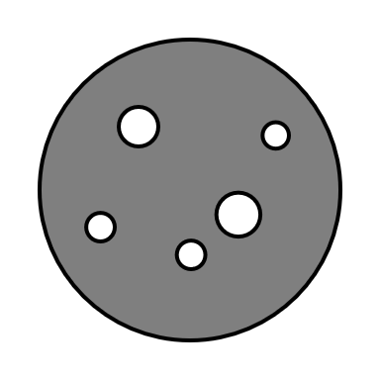
Objective
To design a reusable device for the human lander system that will dissipate the impact energy in such a way that it does not damage the vessel or occupants.
Tristan Jenkins
Notes:
The main objective of this project is to design a reusable shock absorber system for the human lander. This system must be able to safely dissipate the impact energy upon landing without hurting the astronauts or damaging any of the cargo on board. The main motivation behind this project is mission Artemis.

Slide 5
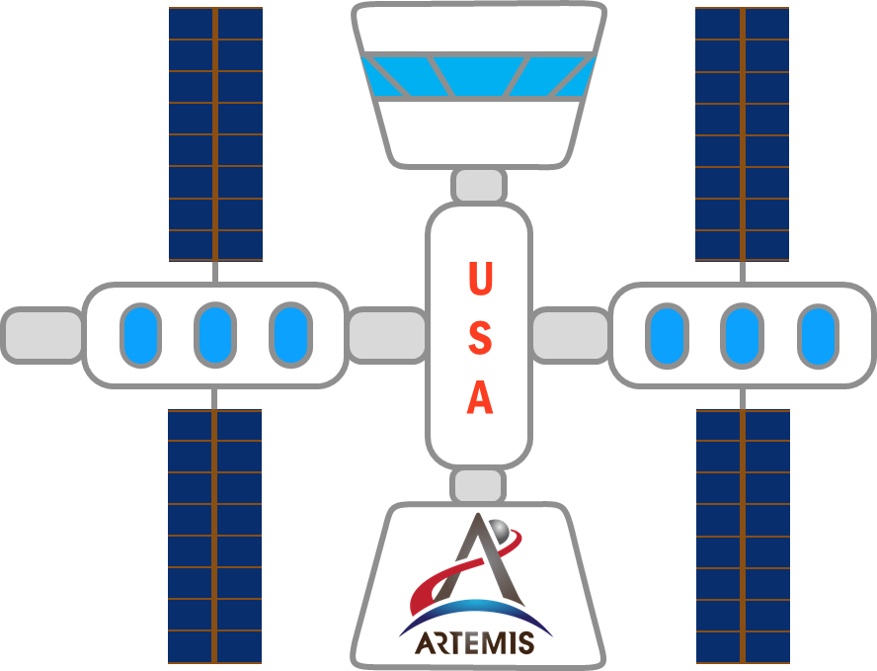

Project Description
Project Motivation
Tristan Jenkins
Notes:
The motivation behind our project is Mission Artemis. The goal of Mission Artemis is to establish a human presence on the moon. To accomplish this humanity needs to establish a both a lunar base and an orbiting space station. Or course humans will need a way to transit between the moon base and the space station, and that is where our project comes in. The last class of lunar lander was equipped with single use shock absorbers that were discarded on the moon when the astronauts left. A natural question to ask is “Why did they do that?”
The purpose of mission Artemis is to establish a human presence on the moon. The short term goal is to put the 1st woman, and the next man on the moon by 2024. The long term goal is to establish a human presence on Mars by 2033. During this mission, NASA will be putting a space station into lunar orbit around the moon allowing for the ability to make multiple trips back and forth. Mission Artemis acts as the first step in order for us to focus on our goal of exploring mars in 2033.
In previous missions to the moon, the shock absorbers used on the human lander would crush in on itself, only allowing for a single-use. This is where our project comes into play, since NASA wants to make multiple trips to the moon, our device must be reusable. This will allow us to explore more areas of the moon since the lander will be able to take off or hop from one location to the next.

Slide 6
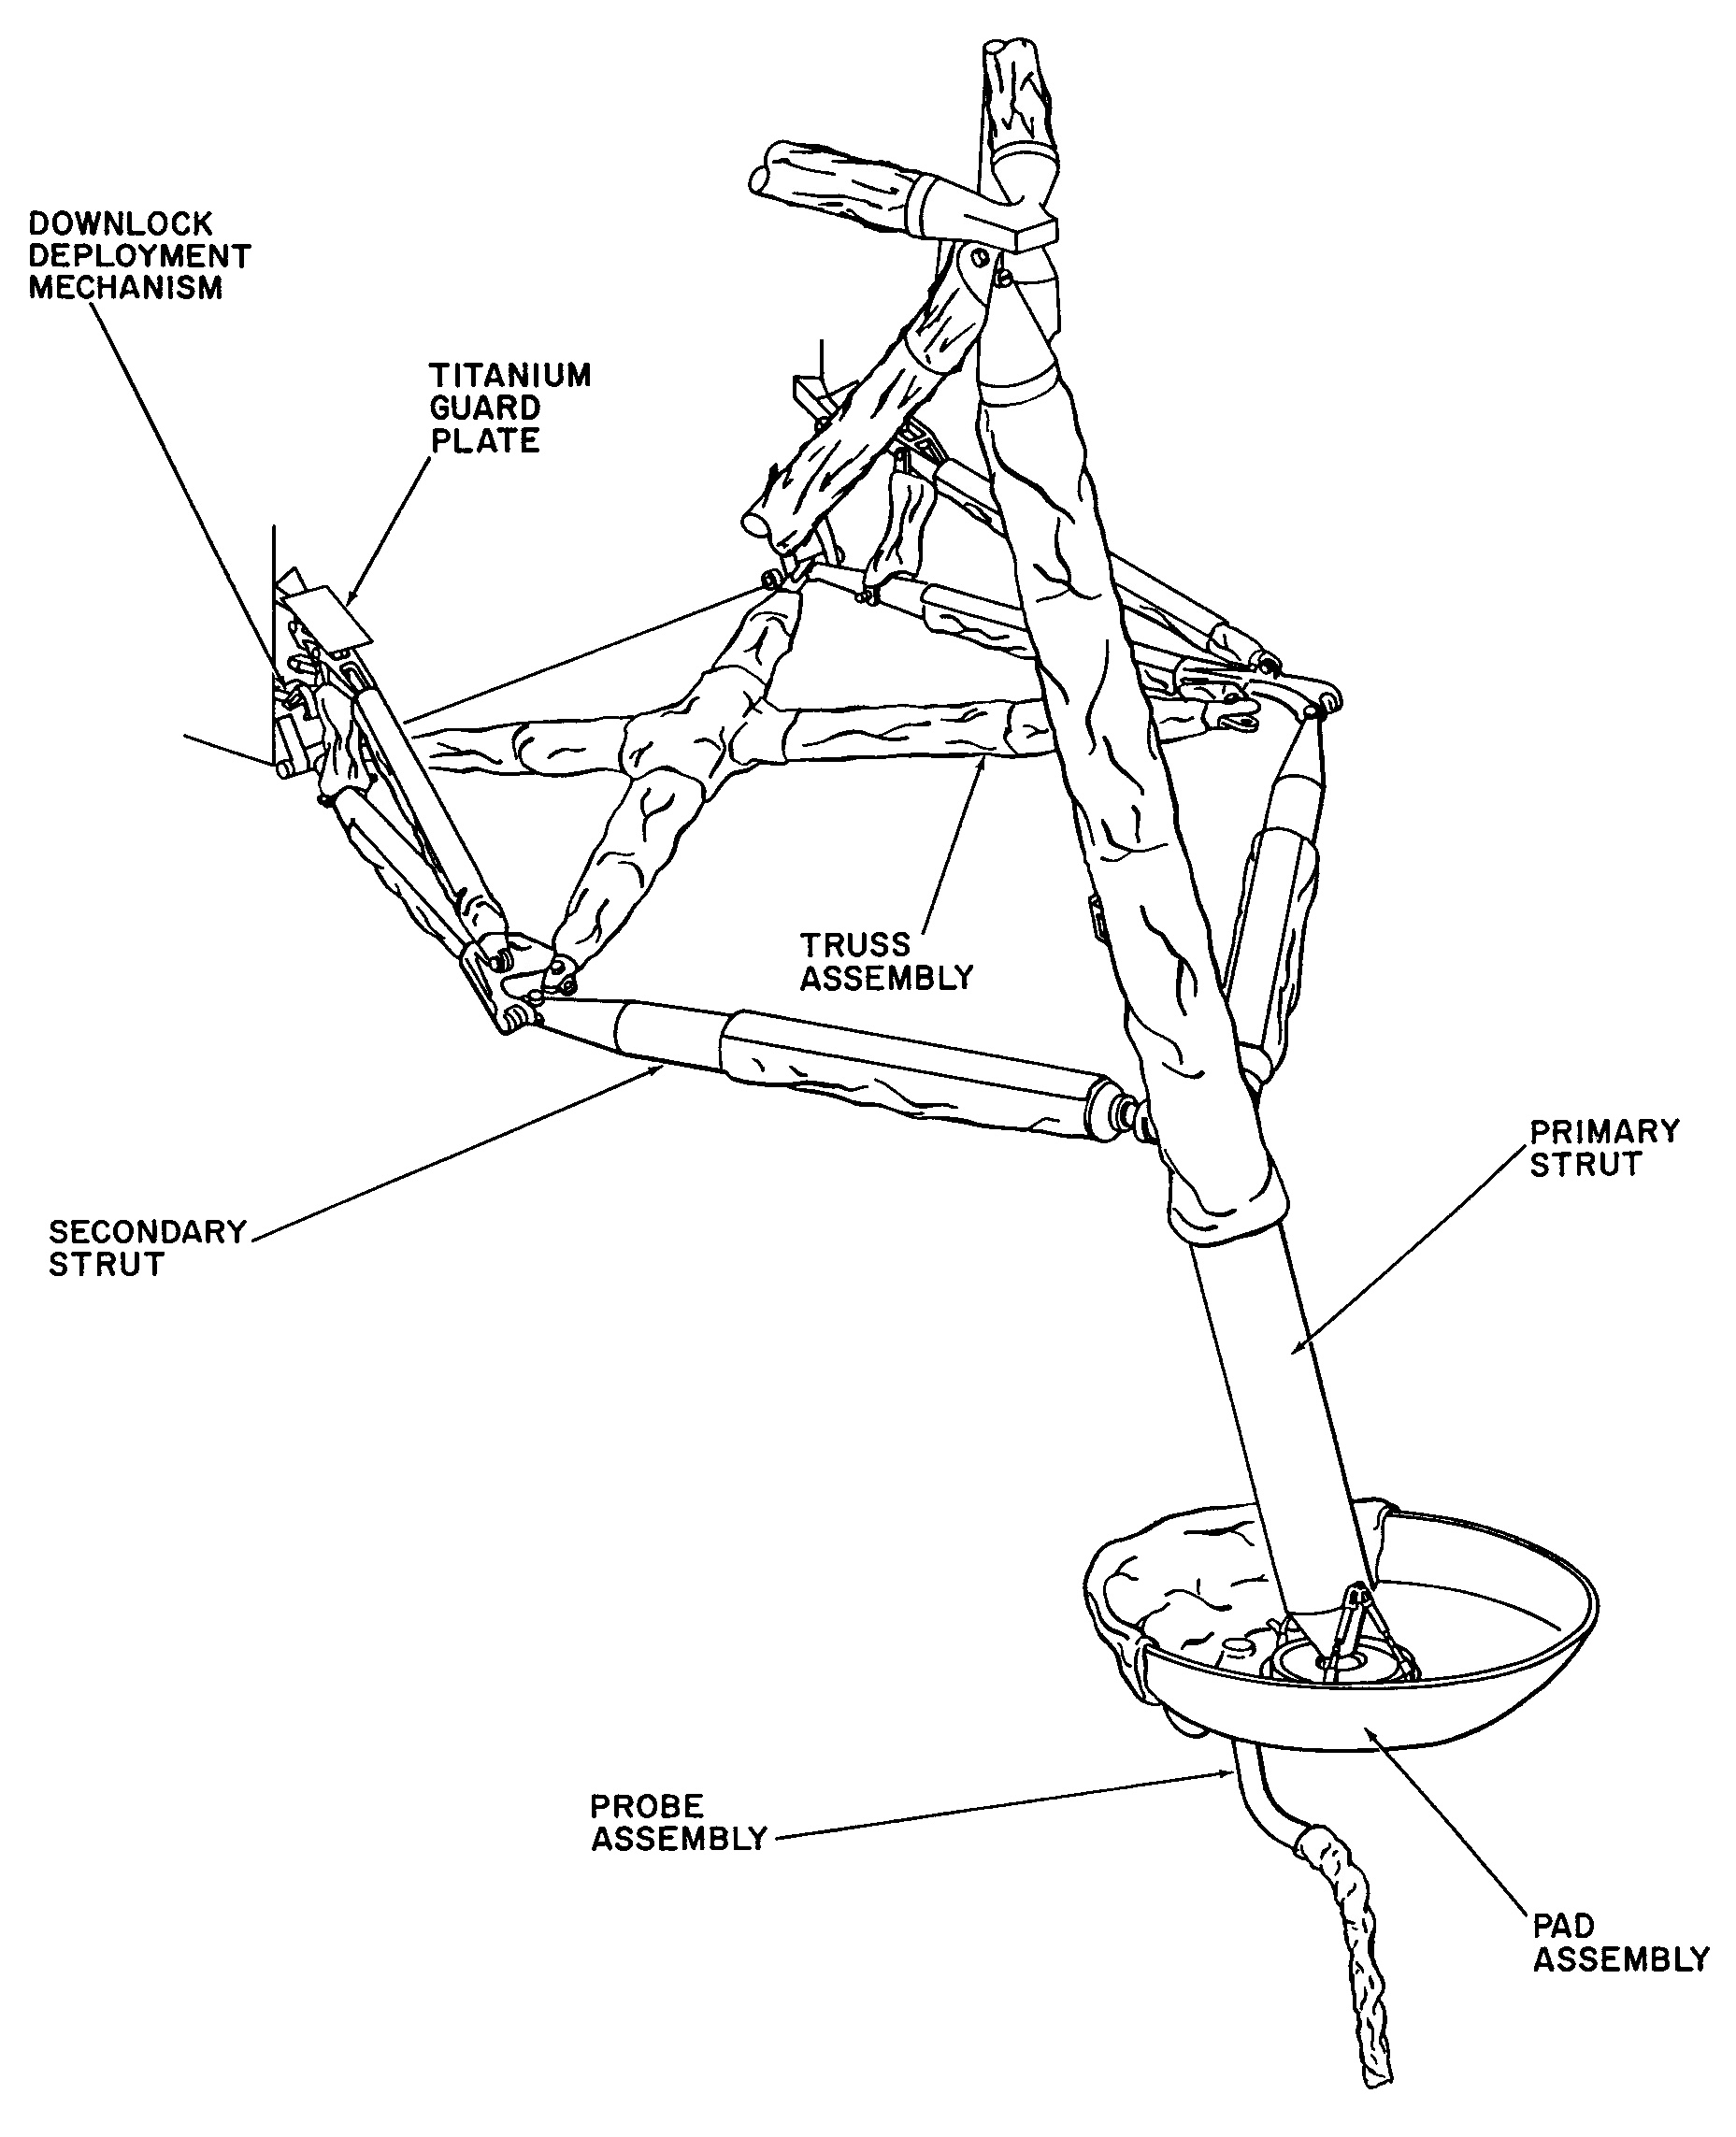
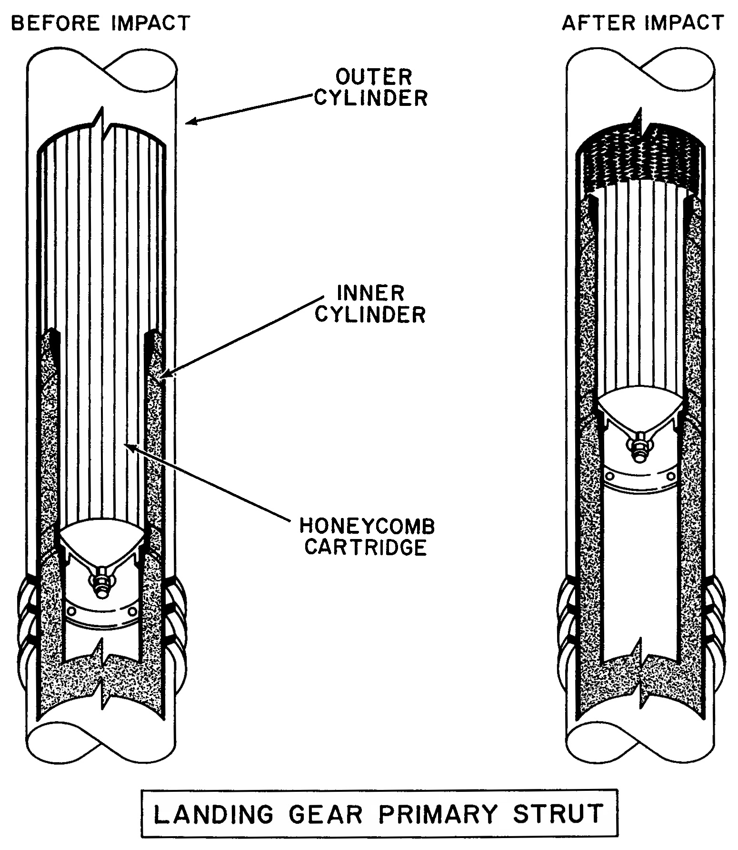
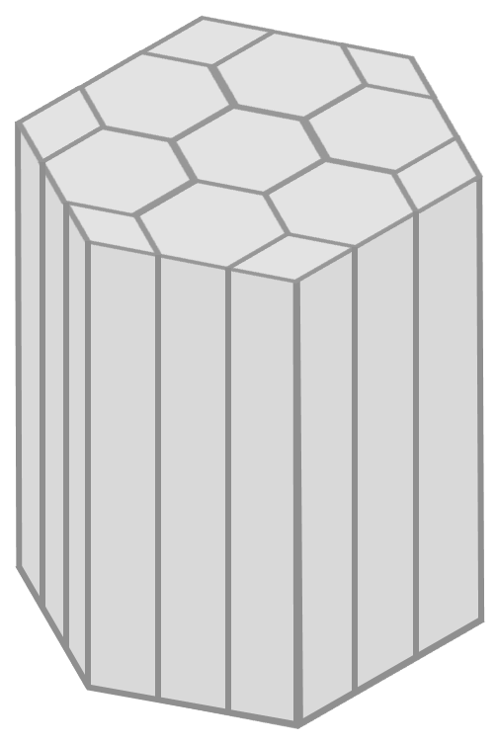
Apollo Shock Absorber
Apollo Shock Absorber
LANDING GEAR ASSEMBLY
[1]
ALUMINUM HONEYCOMB VISUAL AID
LANDING GEAR PRIMARY STRUT
[1]
Melanie Porter
Notes:
The Apollo class shock absorber was single use because the lunar module didn’t come home; it burned up in the earth’s atmosphere upon reentry. NASA engineers used this to their advantage and fitted the lunar module with an incredibly light weight and effective shock absorber: The Crushable Aluminum Honeycomb. As the name implies the shock absorber was a hexagonal aluminum extrusion that was crushed upon impact. The impact energy was absorbed by the plastic deformation of the aluminum. The picture on the left shows the physical assembly of each leg of the Apollo lander, with the primary strut attached directly to the footpad. The picture on the right shows a cutaway of the primary strut before and after landing, and the center picture is a computer model of the honeycomb.

Slide 7


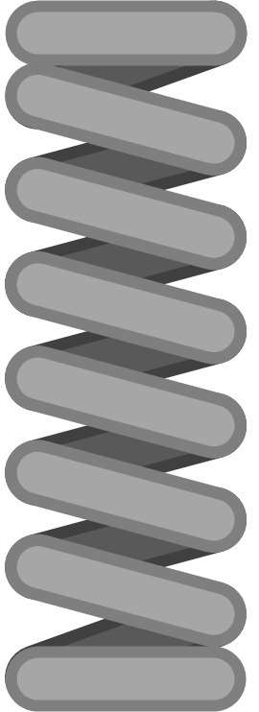



Traditional Shock Absorbers
2) Fast Compression
No Fluids
1) Impact
3) Heat Dissipation
No Heat
Dissipation
4) Slow Expansion
Melanie Porter
Notes:
Traditional shock absorbers use fluids to dampen the rebound of a spring. When a normal shock absorber is impacted, part of the energy is absorbed by the spring as elastic deformation, and part of the energy is used to compress the working fluid. When the fluid is compressed, the temperature rises, and excess energy is radiated away as heat. That fluid is then slowly allowed to expand, which is where the damping comes from. *CLICK* But environmental conditions on the moon pose a challenge to fluid-based shock absorbers, and makes heat dissipation almost impossible.

Slide 8

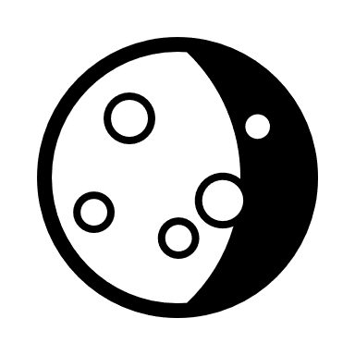
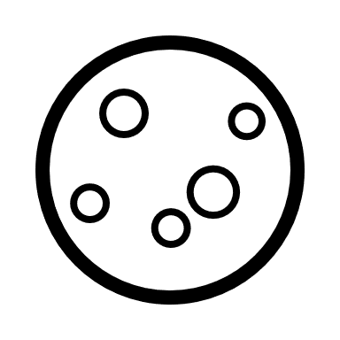










Functions
Design Stages
#1
Project
Scope
Customer
Needs
Background
Research
Functional
Decomp
Targets &
Metrics
Concept
Generation
Concept
Selection
Link
Matt Fowler
Notes:
Earlier In the semester we identified the functions that our product would need to perform, and we have highlighted the critical function in yellow. *say each critical function*
Project Scope
Customer Needs
Research
Functional Decomposition
Targets and Metrics
Concept Generation
Concept Selection

Slide 9
Functions
Functions
Shock Absorber
Support
Impact Reduction
Reusability
Absorb Shock
Support Mass
Absorb Impact Energy
Returns to original state
Dampen Vibrations
Transform Energy
Indicate Reusability
Link
Prevent Excessive Rebound
Dissipate Energy
Store Energy
Matt Fowler
Notes:
This is our functional decomposition. We first broke our project down into 3 major functional systems systems: Support, Impact Reduction, and Reusability.
We then broke down each system into sub-function, with our most important functions highlighted in yellow (then read off the critical functions, don’t need to read off each item on the slide)

Slide 10
Spider Legs
Rotary Friction Dampers
Positioning Springs
Not To Scale
Team 515
Con
Concept #6
Page 1/4
M. Porter
Notes:
The concept is called Spider Legs and was a product of biomimicry. The landing gear would use multi jointed legs with rotational friction dampers at each joint and compression springs in between each joint to position the legs. The legs would fold in on themselves during landing and the friction dampers would slow the process.

Slide 11
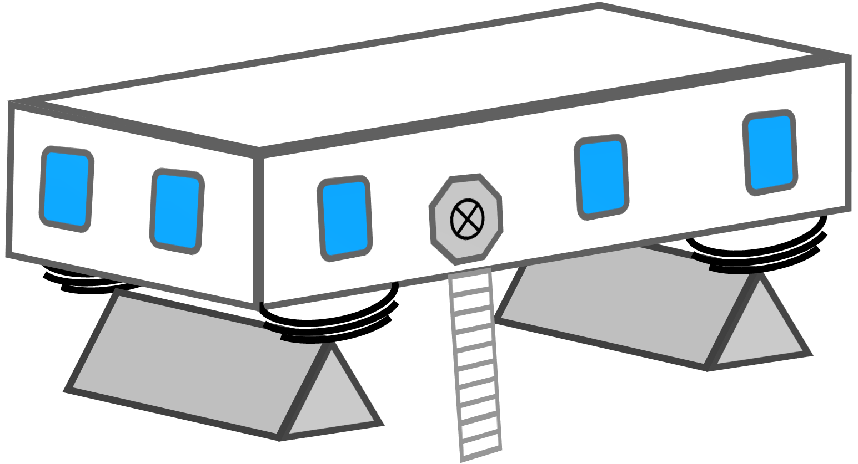
Leaf Springs
Not To Scale
Leaf Springs
Team 515
Con
Footpad ‘axle’
Concept #2
Page 2/4
M. Porter
Notes:
This concept revolved around using leaf springs as the shock absorbers. Leaf springs are used as shock absorbers on heavy duty equipment, but leaf springs have been used for thousands of years on chariots as shock absorbers because they are simple, robust, and self damping. The frictional forces between the leaves dissipate kinetic energy as heat.

Slide 12

Weighted Springs
Not To Scale
Team 515
Con
Concept #4
Page 3/4
M. Porter
Notes:
This concept was known as weighted springs, and it used weights positioned by motors to damp out vibrations, similar to how noise cancelling headphones work.

Slide 13
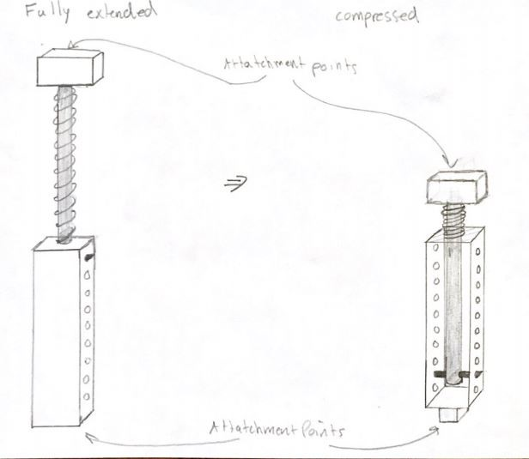
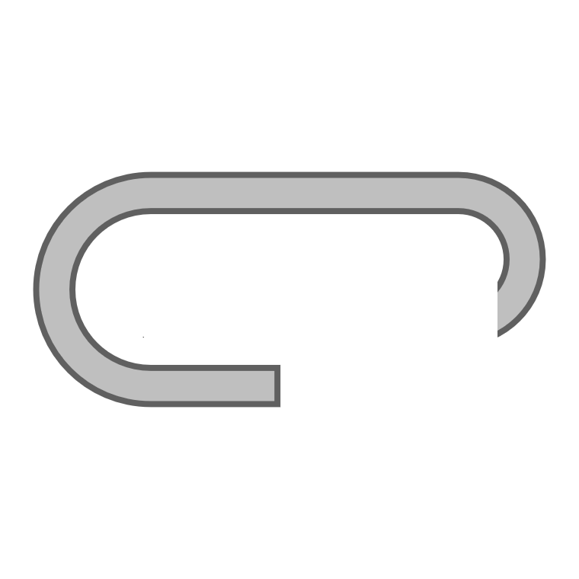

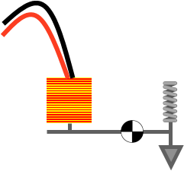
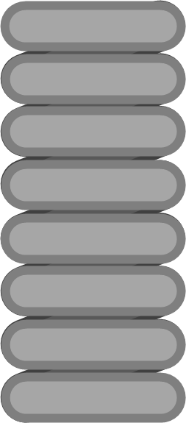
Locking Spring
Compressed
Extended
Ratchet
Solenoid
Not To Scale
Team 515
Con
Spring Pawl
Concept #7
Page 4/4
M. Porter
Notes:
This concept was the idea of storing the impact energy as elastic deformation in a spring. The shock absorber would work by mechanically locking a spring at its maximum compression. The drawing in the top right shows our first sketch of this concept and the cartoon shows our first thoughts on an unlocking mechanism. This is the concept that we decided to move forward with and Tristan will tell us more about why we chose it.

Slide 14



Attractive Features
Stored energy can assist in liftoff
Solenoids are only briefly active
Works even in a loss of power
Tristan Jenkins
Notes:
Besides weight, there were three things we really liked about the locking springs concept.
The first is that the design works even in the loss of power. If there were some kind of emergency during landing it would be beneficial to have a shock absorber that still functions.
The second thing is that the stored energy could be released during liftoff. This could possibly lower the amount of fuel needed to leave the surface and increase overall mission efficiency.
The solenoids would only need to be activated for a brief amount of time, because the solenoids are used to unlock the device. If the solenoids were used to lock the spring in place they would need to be on the whole time.

Slide 15
Locking Spring
Pawl Arm: locks ratchet
Ferromagnetic Core
Linear Ratchet: compresses spring
Solenoid: pulls to release pawls
To Lander
Main Spring: stores energy
Not To Scale
Extension Spring:
closes pawls
Team 515
Con
Rev: 1
Page 1/1
T. Jenkins
Notes:
Main components to cover and their functions:
Main spring: elastically deforms to absorb impact energy
Linear Ratchet: compresses spring
Pawl arms: locks the ratchet in place, which locks the spring
Extension springs: keep the pawls shut
Solenoids: open the pawls to release the ratchet, which allows the main spring to expand

Slide 16
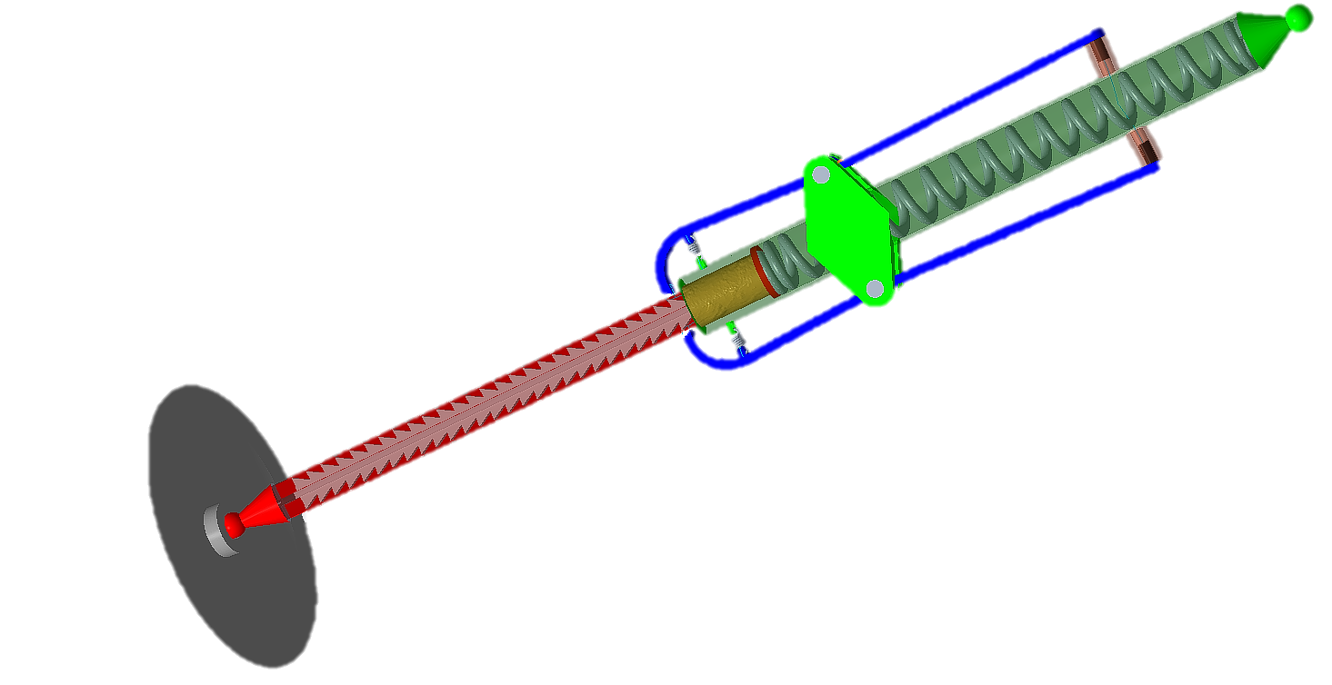
First Design Iteration
Tristan Jenkins
Notes:
This was our first design iteration, and it looks very cool and we were very proud of it. As we were designing it we were focused mostly on the materials being able to withstand the loads that they would be subjected to, and it looked like it was going to work well, but we ran into problems with the pawls springs. Let’s look at our free body diagram.

Slide 17
Dynamic Feasibility
M_{pawl} = 0
F_{Friction}
F_{Extension}
F_{Solenoid}
F_{Main}
Extension Spring
Force
Length
Needed
8 kip
< 13 inches
Realistic
4 kip
> 200 inches
Matt Fowler
Notes:
So here’s our simplified drawing of the design *CLICK* and here’s the free body diagram.
The important things to note here are that:
1) The moment about the pawl pin will always need to be balanced to zero.
2) When the pawls are closed the only applicable forces are from the main spring and extension spring
3) All four forces are applicable when the pawl is being opened.
We centered our design around the main spring, so we know that force and the frictional force, and from there we found our needed extension spring force and solenoid force. But, we ran into a problem when we were designing our extension spring. *CLICK* We needed a spring that was at most 13 inches long, *CLICK* but that doesn’t physically exist for the kind of force we needed.

Slide 18



Root Cause Analysis
“We didn’t know that we had assumed.”
“Scale of forces is beyond our conception.”
Matt Fowler
Notes:
When hitting a wall like this in a project we feel that it’s important to identify why we hit this wall in the first place.
*CLICK*
Our main focus was on designing the main spring and making sure that the materials would be able to withstand the forces we would be subjecting them to. We had figured that those would be our limiting components and apparently just assumed that we would be able to design a spring to meet our geometric and force needs.
*CLICK*
The bigger question though is why we assumed this in the first place. We think that a part of the answer to that question is that the scale of these forces is far beyond our conception. it’s easy for us imagine that things will work on a scale that we are used to, but on this project we are dealing with much bigger forces than we deal with in our daily lives. It’s easy for us to put a rubber band around a piece of plastic and imagine that something geometrically similar will work in full scale.

Slide 19
X
Locking Spring
“Vice Grips” style 4-bar linkage → Increase Mechanical Advantage
Still too much force!
Not To Scale
Team 515
Con
Rev: 2
Page 1/1
M. Fowler
Notes:
After talking with our professor, Dr. McConomy, we decided to try to use a 4-bar linkage design to increase our mechanical advantage, *CLICK* but the force was so large that in order to keep our pins from sheering we would need to have comically large links.

Slide 20
Locking Spring
Pawl Connection
Keyed Motor Housing
Pawl
M
Motor
Not To Scale
Ratchet Screw
Thrust/Radial bearing
Team 515
Con
Rev: 3
Page 1/1
T. Jenkins
Notes:
After that we talked with our faculty advisor, Keith Larson. We told him about another idea from our meeting with Dr. McConomy which was to use the pawl arms themselves as the closing springs. The challenge with that is how to open the pawls to release the spring. Together we came up with the idea of a ratchet screw. Basically, the screw will ratchet in axially just as with our previous design. Instead of the pawls rotating about a point, they are deflected outward by the force of the incoming ratchet. After impact, a motor would either rotate the screw or rotate the pawls to slowly extend the screw outward.

Slide 21
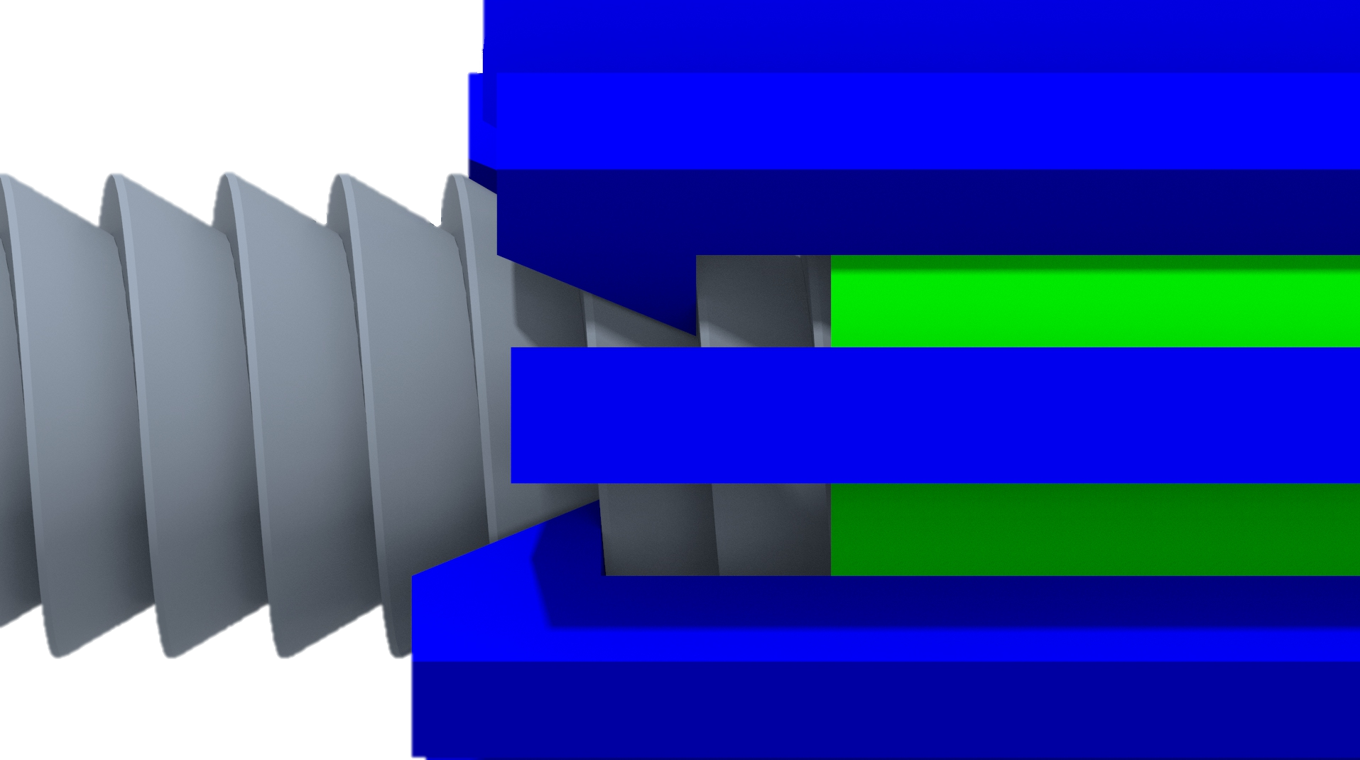
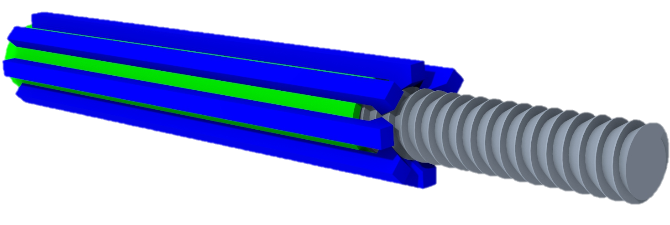
Ratchet Screw
Staggered Pawls
Ratchet Helix Profile
Angled Pawl Teeth
More Pawl Arms
Tristan Jenkins
21
Notes:
So now let’s talk about some of the benefits and considerations with this design:
1) More pawl arms. The immediate benefit with this design is that we can place more pawl arms around the radius of the cylinder, which lowers the load any individual arm carries.
2) The pawl teeth will need to be staggered in order to have them all be engaged at the same time
3) The pawl tooth will need to be angled to match the pitch of the ratchet screw
4) The profile of the helix is such that the ratchet side is at a 30 degree angle with the screw axis, and the back side is at 90-degree angle for the pawl arms to grab onto.

Slide 22
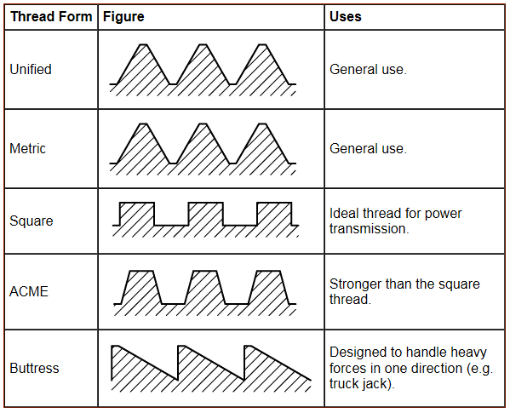
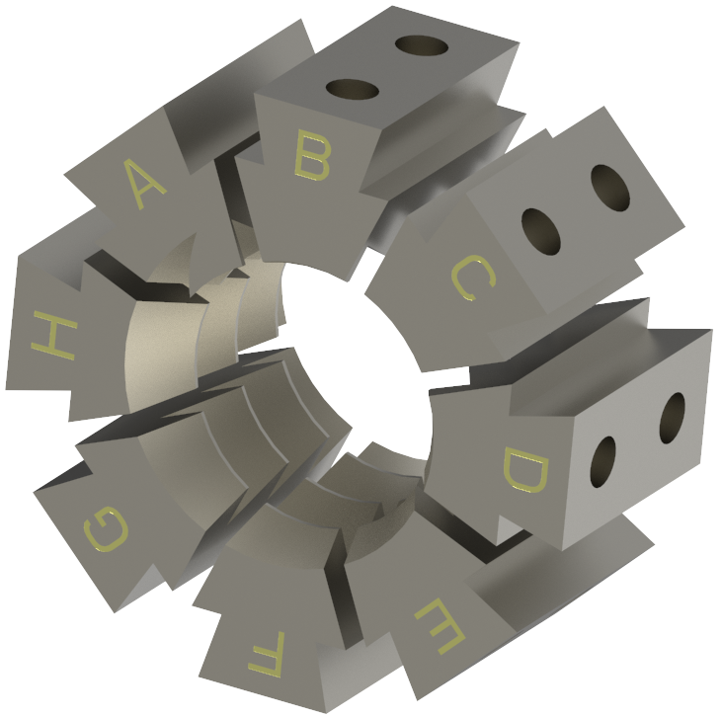
Buttress Threads & Half Nuts
Melanie Porter
Notes:
We found out that our “ratchet screw” had already been invented and is commonly known as a “buttress thread”. Buttress threads were once commonly used in heavy loading situations like in truck jacks and in artillery, but they are less common than the acme thread today. We did not find any instances of buttress thread being used in a ratcheting application, but as shown on the thread chart its standard profile is very similar to our design. This “standard profile” opened the door for us to investigate the use of quick release “half nuts” that are commonly used on vices. CLICK We investigated the possibility of using a partial nut attached to the end of each pawl arm to create a whole nut that the ratchet screw could rotate against. We can not use the nut as a quick release, because that would require similar amounts of force as our original design, but we can use the nuts to provide multiple threads of engagement on each pawl arm. The eighth nuts also simplify the complex geometry of the pawl arm and remove the need to stager the pawl arms.

Slide 23
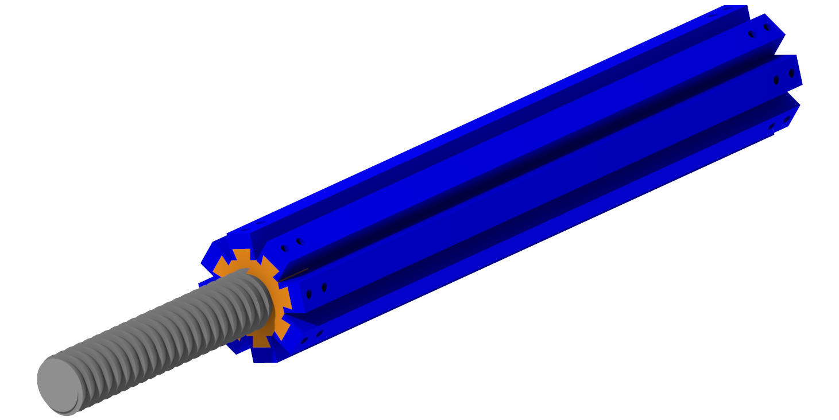
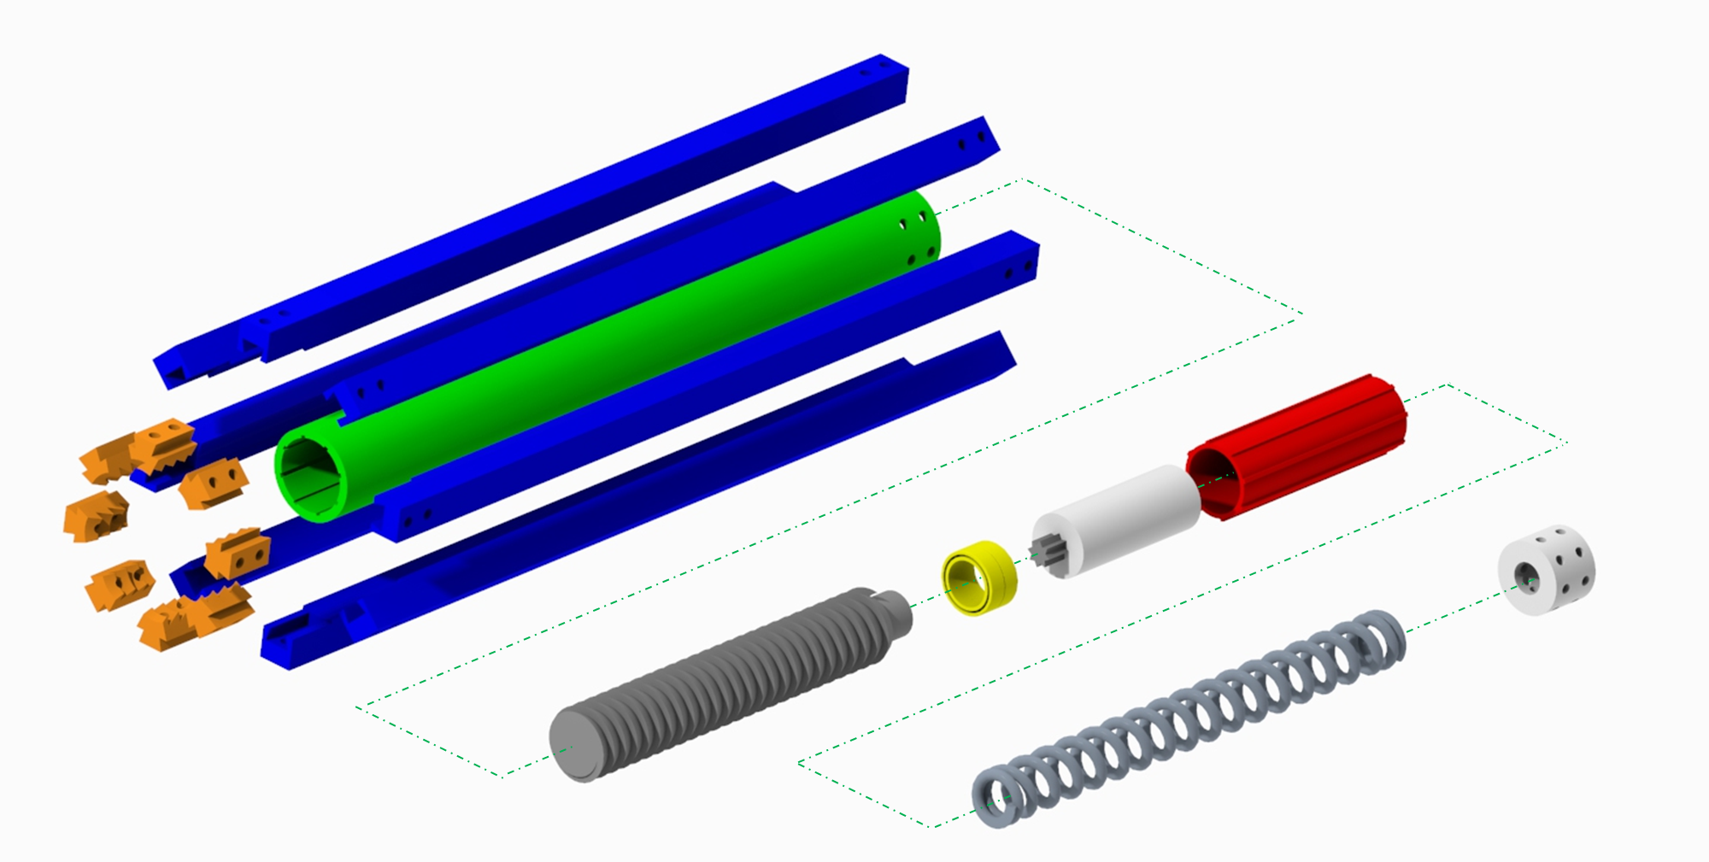
‘Final’ Design
Melanie Porter
Notes:
So this here is our final design. You can see the orange eighth nuts make up a whole nut around the ratchet screw. And here is an exploded view.
*CLICK*
In this drawing we can see the orange eighth nuts, which are connected by bolts to the bule pawl arms. The pawl arms are then bolted to the green main cylinder. The ratchet screw is pressed into the thrust bearing and the motor shaft is keyed into the ratchet screw. The motor is put into the motor housing and the thrust bearing is pushed up against the motor housing. The screw, thrust bearing, and motor housing are then inserted into the main cylinder. The main spring is inserted behind the motor housing and the end cap is inserted to provide a surface for the spring to interact with and provide a mount for the pawl arm bolts.

Slide 24



Prototypes
Alex Noll
Notes:
Right now, we are working on three separate prototypes, each focused on a different test: A spring test, a locking mechanism test, and an unlocking mechanism test.

Slide 25
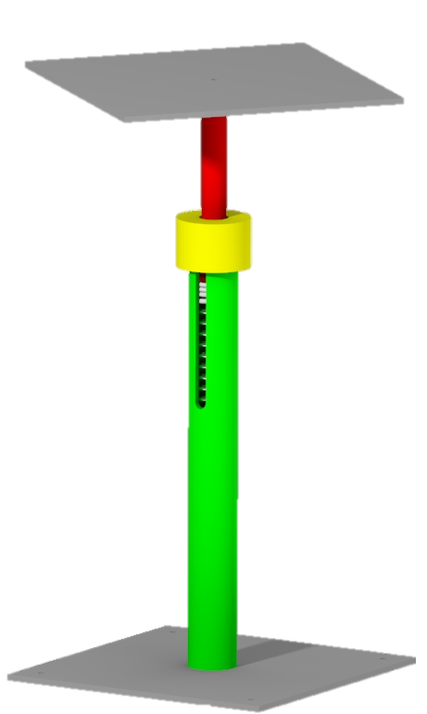
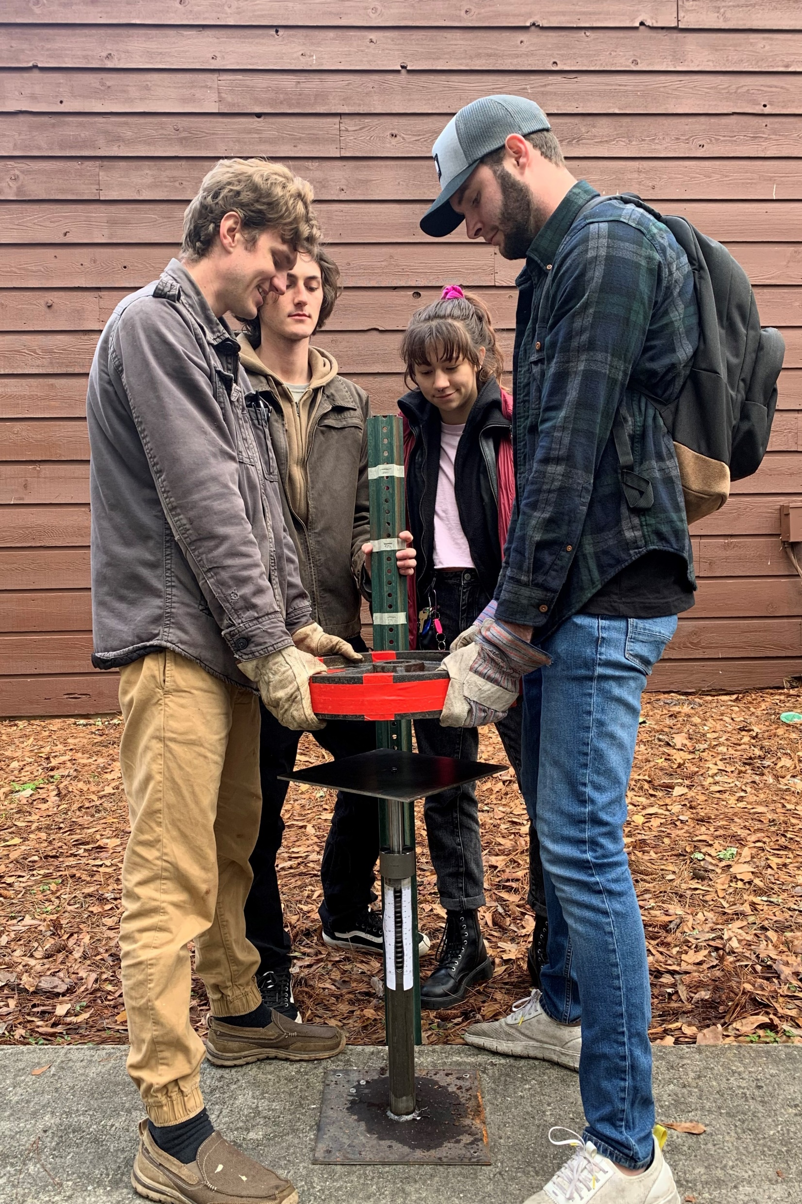
Spring Test Prototype
~1/3 Geometric scale
1/645 Force scale
kg
Test spring deflection on impact
Alex Noll
Notes:
Our first prototype is our spring test rig. The geometry of the prototype is based off of the scale of the spring that we chose for our prototype. The spring itself has a stiffness scaling factor, and from those two scales we were able to dynamically scale the force we will need to provide to simulate an impact. The goal of the spring prototype is to test that our spring will deflect the designed amount under load.

Slide 26
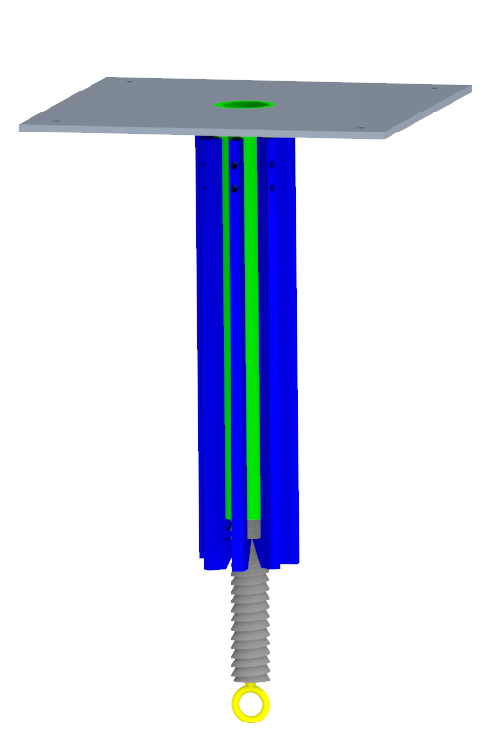

Locking Test Prototype
Same scales as spring prototype
Test ratcheting movement
Test pawls under load, 141 lbs
kg
kg
Alex Noll
Notes:
As of right now, the locking test prototype is going to have the same scales as the spring prototype. This is being done for convenience and in the hopes that we can combine all of our prototypes in the end to make a complete prototype. The purpose of this prototype is to test that the ratchet screw and pawls move as expected, and to test that the pawls will hold the ratchet screw under load. The plan is to hang the scaled load, 141 pounds, from the end of the ratchet screw.

Slide 27

Unlocking Test Prototype
Same scales as spring prototype
M
Test unlocking movement under load
Why a separate prototype?
kg
Alex Noll
Notes:
The unlocking prototype will be using the same scaling factors as the other prototypes. The goal of this prototype is to check if our unlocking mechanism is able to function under load.
A normal question to ask is why are we building two different prototypes if they are effectively the same thing? The unlocking and locking prototypes may actually be made from the same components. In a perfect world that would be the case, but we still have a lot of work to do with our locking mechanism, and even more to do with our unlocking mechanism. It may not be possible for us to test the locking and unlocking mechanisms in the same way, so we don’t want to paint ourselves into a corner by committing to do all the tests with one prototype. If we can, we will; if we can’t, we planned for that anyways.

Slide 28
Prototype Budget
Spring Prototype
Locking Prototype
Prototype
Price
%
Balance
Allotted
$2000
100%
Spring
$216
10.8%
Locking
$750
37.5%
Unlocking
$750
37.5%
Total
$1716
85.8%
Unlocking Prototype
Alex Noll
Notes:
And here is our budget breakdown. Our sponsor allotted us $2000 for our project. So far we have spent $216 to build our spring prototype. We have allotted ourselves $750 to build each of the remaining two prototypes, which will leave us with almost $300 to cover any unforeseen costs along the way.

Slide 29






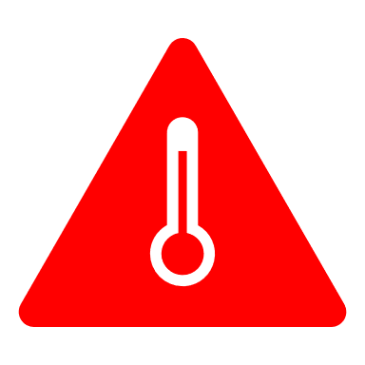
Future Work
M
M
Test components
Josh Blank

Slide 30
Future Work
M
Cam-esque
tooth shape
Josh Blank

Slide 31
Future Work
M
Integrate shock
absorber
Josh Blank

Slide 32
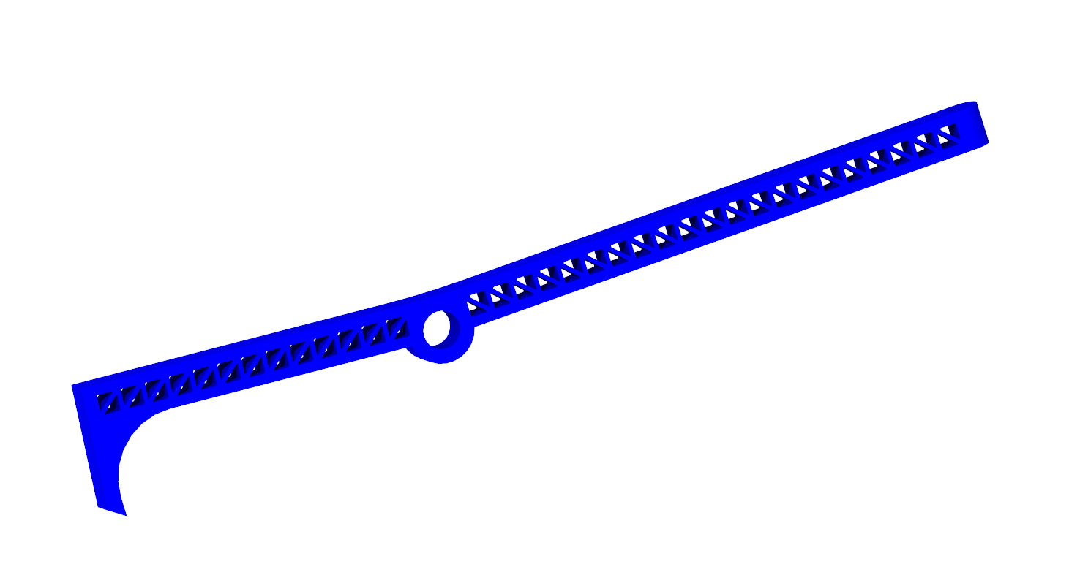
Future Work
M
Lightweight geometry
Josh Blank

Slide 33
Future Work
M
Develop regolith shields
Josh Blank

Slide 34
Future Work
M
Parabolic pawl arms
M
Josh Blank

Slide 35
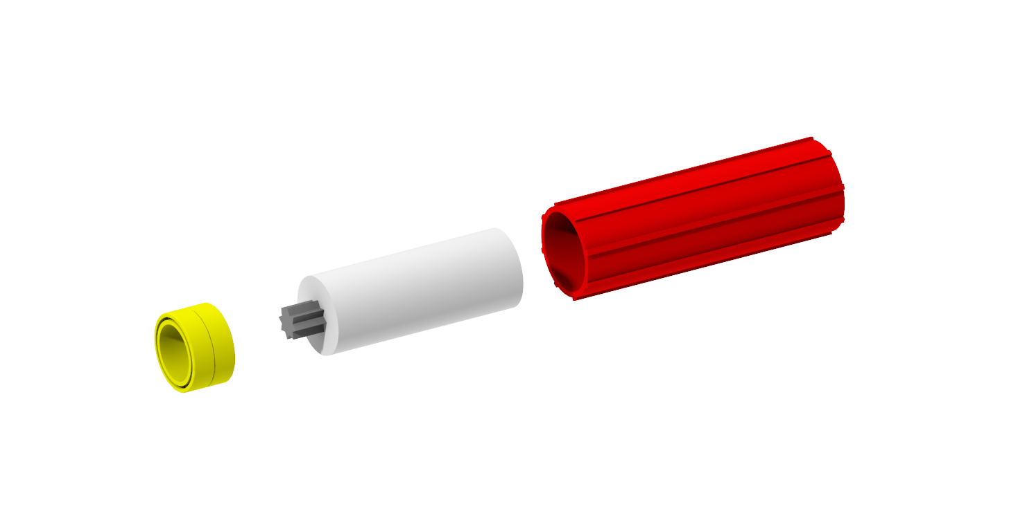
Future Work
M
Design thrust bearing, motor, and gear box.
Josh Blank

Slide 36
Project Recap
Josh Blank
Notes:
Humanity faces sustainability issues both on earth and off of earth. If we are to expand our species beyond the limits of our home planet then we need to increase our sustainability in space, and one facet of that problem is the use of shock absorbers.
We’re going back to the moon, but we’re not stopping there. Mission Artemis is humanity’s small step to the giant leap that is colonization of our solar system. If we’re going to successfully colonize mars we are going to need to solve the sustainability issues of traversing space, and shock absorbers are a small facet of that problem.
Over the course of our senior year we attempted to solve that problem, and we don’t have a complete solution yet but that’s okay because we did a lot and I am proud of what we have accomplished. We broke down the essence of a shock absorber. We thought outside the box when we decided to store the impact energy instead of trying to dissipate it. We came up with a new way to use, combine, and augment existing technology. We ran computer models to validate our designs, then designed and built prototypes to test our designs. And we did all of this during an unprecedented global pandemic.
We have engineered a device that we feel has a real potential to be integrated into a reusable shock absorbing system.
So did we get something out of this project? Yeah, we got some things.

Slide 37




Some Things
…we wish we did better
…we learned
…that helped us
Josh Blank
Notes:
Some things that we wish we did better:
After doing the design process that led us to the shock absorbing method of using a locking spring, we should have done a second design process to help us come up with a design of our concept. We also should have done more rough calculations as we were drawing components, which could have told us if our designs were even feasible.
There were some things we learned:
One of the biggest lessons that we learned was to keep moving forward, even if it’s just barely. In the words of our project sponsor “Some of the biggest failures produce the biggest successes.”
We also learned how to incorporate respect for each other into all aspects of our project. From the get go our team worked well together but learning how to maintain respectful relationships with each other was crucial in maintaining our team dynamic.
And there were some things that we realized we were doing right. We started our work early and were able to dedicate an appropriate amount of time to the project. We always tried to frontload our work, and we found that once we had work started it was easier to work on later. We’re also really proud of ourselves for reigning in the scope of this project. Our decision to limit this project to only the shock absorber instead of trying to develop an entire leg system was instrumental in ensuring that we could design a quality product for NASA to evaluate.
But most importantly we played to our strengths,

Slide 38
Our Strengths
Creativity
Mathematic
Disposition
Ingenuity
Conceptual
Vision
Professionalism
Notes:
I say that matt’s strength was his mathematic disposition (unless anyone knows the word for the quality of being good at math) then matt says Tristan’s, Tristan says alex’s, alex says melanie’s, melanie says mine and then I say thank you are there any questions as we advance the slide.

Slide 39
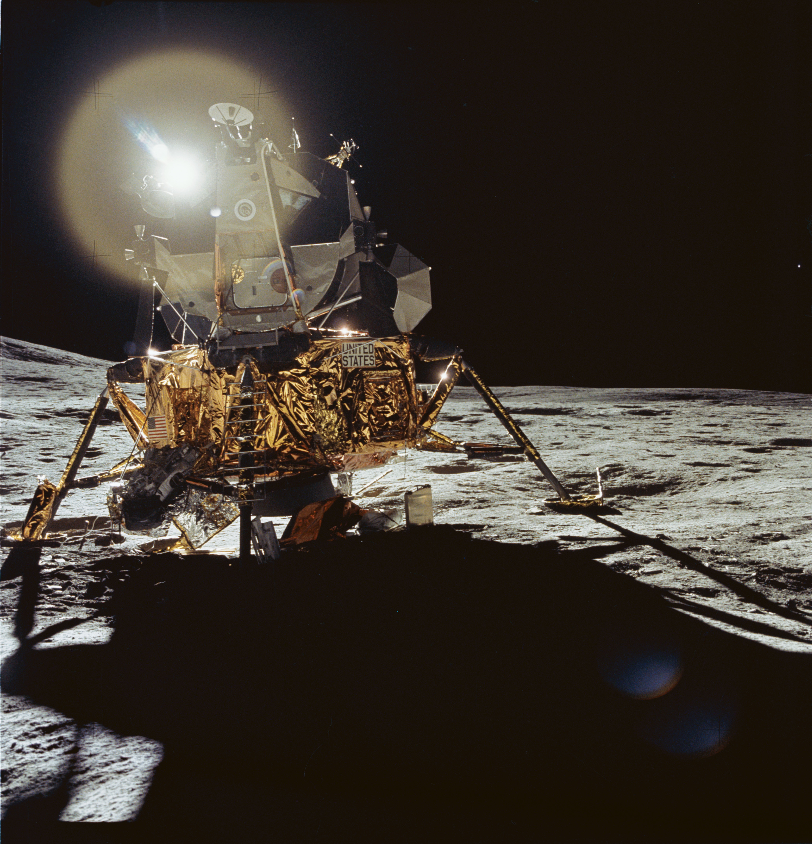





Thank You!
Josh Blank
Matt Fowler
Tristan Jenkins
Alex
Noll
Melanie Porter
Joshjblank
@gmail.com
Matthewisfowler
@gmail.com
Tristanjenkins15@gmail.com
Al3xnoll
@gmail.com
Melaporter19
@gmail.com

Slide 40
References
[1] Rodgers, W. F. (1972). Apollo Experience Report – Lunar Module Landing Gear Subsystem (NASA TN 0-6850). Washington , D.C. : National Aeronautics and Space Administration.
[2] INCO. (1974). Materials for Cryogenic Service: Engineering Properties of Austenitic Stainless Steels. Nickle Development Institute .

Slide 41
Backup Slides

Slide 42
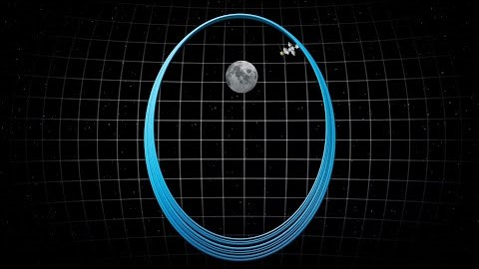
Back Up Project Description

Slide 43
Back Up Functional Decomp
Functional Decomposition Cross Reference Table. Rows more important than columns
 | Withstand Shock | Support Weight | Absorb Impact Energy | Dampen Vibrations | Prevent Excessive Rebound | Transform Energy | Dissipate Energy | Store Energy | Return to Origingal State | Sum
Withstand Shock | - | 1 | 0 | 1 | 1 | 1 | 1 | 1 | 1 | 7
Support Weight | 0 | - | 0 | 1 | 1 | 1 | 1 | 1 | 1 | 6
Absorb Impact Energy | 1 | 1 | - | 1 | 1 | 1 | 1 | 1 | 1 | 8
Dampen Vibrations | 0 | 0 | 0 | - | 0 | 0 | 1 | 1 | 0 | 2
Prevent Excessive Rebound | 0 | 0 | 0 | 1 | - | 1 | 1 | 1 | 0 | 4
Transform Energy | 0 | 0 | 0 | 1 | 0 | - | 1 | 1 | 0 | 3
Dissipate Energy | 0 | 0 | 0 | 0 | 0 | 0 | - | 1 | 0 | 1
Store Energy | 0 | 0 | 0 | 0 | 0 | 0 | 0 | - | 0 | 0
Return to Origingal State | 0 | 0 | 0 | 1 | 1 | 1 | 1 | 1 | - | 5
Rank | 2 | 3 | 1 | 7 | 5 | 6 | 8 | 9 | 4
Rank | Function
1 | Absorb Impact Energy
2 | Withstand Shock
3 | Support Weight
4 | Return to Original State
5 | Prevent Excessive Rebound
6 | Transform Energy
7 | Dampen Vibrations
8 | Dissipate Energy
9 | Store Energy

Slide 44

Back Up Concept Selection: HoQ
 | Importance rating | Absorb Impact Energy | Absorb Structural Shock | Support Mass | Return to Original State | Indicate Reusability | Prevent Excessive Rebound | Transform Energy | Dampen Vibrations | Dissipate Energy | Store Energy | Withstand Lunar Conditions
The product can be used indefinitely. | 3 | 3 | 2 | 2 | 3 | 2 |  | 1 | 1 | 1 | 1 | 3
The product is lightweight. | 3
The product can be sent to the moon and used repeatedly. | 3 | 3 |  | 1 | 3 | 2 |  |  |  |  |  | 3
No routine maintenance is necessary during remainder of each lunar trip. | 1 |  |  |  | 2 | 1
Shock absorber dynamic qualities does not change or diminish after an impact. | 2 | 2 | 2 | 1 | 1 |  | 1 | 1 |  | 1 | 1
The product can handle an impact speed of 10 feet per second. | 3 | 3 | 3
The product can support 25,000 kg. | 2 |  | 3 | 3 |  |  | 2
The product can land at up to a 10-degree offset from the z-axis. | 1 |  |  |  |  |  | 1
Raw Score (total) | 146 | 31 | 21 | 17 | 21 | 13 | 7 | 5 | 3 | 5 | 5 | 18
Relative weight (%) | 100 | 21.23 | 14.38 | 11.64 | 14.38 | 8.90 | 4.79 | 3.42 | 2.05 | 3.42 | 3.42 | 12.33
Rank Order |  | 1 | 2 | 5 | 3 | 6 | 7 | 8 | 11 | 9 | 10 | 4

Slide 45
Back Up Concept Selection: Pugh 1
 |  | Concept
Selection Criteria | Datum | 1 | 2 | 3 | 4 | 5 | 6 | 7 | 8
Absorb Impact Energy | Apollo Shock Absorbers | - | s | + | + | + | s | + | s
Absorb Structural Shock |  | - | + | - | + | + | - | s | s
Support Mass |  | s | s | - | S | s | s | s | s
Return to Original State |  | + | + | + | + | + | + | + | +
Indicate Reusability |  | + | + | + | - | - | + | s | -
Prevent Excessive Rebound |  | - | - | + | + | + | + | + | +
Transform Energy |  | S | + | s | s | s | + | + | s
Dampen Vibrations |  | + | + | + | + | + | - | + | +
Dissipate Energy |  | s | + | s | s | s | + | s | s
Store Energy |  | s | s | s | + | s | + | + | s
Withstand Lunar Conditions |  | - | + | - | - | - | - | s | +
#of pluses |  | 3 | 6 | 5 | 6 | 5 | 6 | 6 | 3
# of minuses |  | 4 | 1 | 3 | 1 | 1 | 3 | 0 | 1

Slide 46
Back Up Concept Selection: Pugh 2
 | Concepts
Selection Criteria | Datum | 2 | 7 | 4
Absorb Impact Energy | Spider Legs | + | + | S
Absorb Structural Shock |  | + | + | +
Support Mass |  | s | + | -
Return to Original State |  | + | + | S
Indicate Reusability |  | s | - | +
Prevent Excessive Rebound |  | - | + | +
Transform Energy |  | + | + | +
Dampen Vibrations |  | - | + | +
Dissipate Energy |  | s | + | S
Store Energy |  | + | + | S
Withstand Lunar Conditions |  | s | + | -
#of pluses |  | 5 | 10 | 5
# of minuses |  | 2 | 1 | 2

Slide 47
Back Up Concept Selection: AHP 1
Criteria Matrix [c]
Customer Needs | Lightweight | Reusable | Dynamic qualities do not change after impact "hopping" | Reduce to <3Gs acceleration | Consistent tooling | handle impact 10ft/s | can support 25000kg | <10 degree offset from z axis
Lightweight | 1.00 | 0.33 | 0.33 | 0.20 | 3.00 | 0.14 | 0.20 | 0.33
Reusable | 3.00 | 1.00 | 3.00 | 0.33 | 5.00 | 0.20 | 0.33 | 3.00
Dynamic qualities do not change after impact | 3.00 | 0.33 | 1.00 | 0.20 | 3.00 | 0.20 | 0.20 | 0.33
Reduce to <3Gs acceleration | 5.00 | 3.00 | 5.00 | 1.00 | 5.00 | 0.33 | 0.33 | 3.00
Consistent tooling | 0.33 | 0.20 | 0.33 | 0.20 | 1.00 | 0.33 | 0.33 | 0.33
handle impact speed 10ft/s | 7.00 | 5.00 | 5.00 | 3.00 | 3.00 | 1.00 | 3.00 | 5.00
can support 32800kg | 5.00 | 3.00 | 5.00 | 3.00 | 3.00 | 0.33 | 1.00 | 5.00
<10 degree offset from z axis | 3.00 | 0.33 | 3.00 | 0.33 | 3.00 | 0.20 | 0.20 | 1.00
Sum | 27.33 | 13.20 | 22.67 | 8.27 | 26.00 | 2.74 | 5.60 | 18.00

Slide 48
Back Up Concept Selection: AHP 2
Normalized Matrix |  |  |  |  |  |  |  |  | {W}
Lightweight | 0.04 | 0.03 | 0.01 | 0.02 | 0.12 | 0.05 | 0.04 | 0.02 | 0.0403
Reusable | 0.1098 | 0.0758 | 0.1324 | 0.0403 | 0.1923 | 0.0729 | 0.0595 | 0.1667 | 0.1062
Dynamic qualities do not change after impact | 0.1098 | 0.0253 | 0.0441 | 0.0242 | 0.1154 | 0.0729 | 0.0357 | 0.0185 | 0.0557
Reduce to <3Gs acceleration | 0.1829 | 0.2273 | 0.2206 | 0.1210 | 0.1923 | 0.1215 | 0.0595 | 0.1667 | 0.1615
Consistent tooling | 0.0122 | 0.0152 | 0.0147 | 0.0242 | 0.0385 | 0.1215 | 0.0595 | 0.0185 | 0.0380
handle impact speed 10ft/s | 0.2561 | 0.3788 | 0.2206 | 0.3629 | 0.1154 | 0.3646 | 0.5357 | 0.2778 | 0.3140
can support 32800kg | 0.1829 | 0.2273 | 0.2206 | 0.3629 | 0.1154 | 0.1215 | 0.1786 | 0.2778 | 0.2109
<10 degree offset from z axis | 0.1098 | 0.0253 | 0.1324 | 0.0403 | 0.1154 | 0.0729 | 0.0357 | 0.0556 | 0.0734
Sum | 1 | 1 | 1 | 1 | 1 | 1 | 1 | 1 | 1.0000

Slide 49
Back Up Concept Selection: AHP 3
Weighted Sum Vector {Ws} | {W} | {Cons}
0.352 | 0.0403 | 8.737873 |  | n | 8
0.992 | 0.1062 | 9.337189 |  | lambda | 9.181082
0.488 | 0.0557 | 8.754142 |  | RI | 1.4
1.546 | 0.1615 | 9.571901 |  | CI | 0.168726
0.323 | 0.0380 | 8.492243 |  | CR | 0.120519
3.004 | 0.3140 | 9.567303
2.080 | 0.2109 | 9.863322
0.670 | 0.0734 | 9.124682
 | Average: | 9.181082

Slide 50
Back Up Spring Prototype
Spring Prototype Calculations
Stiffness Scaler | 0.00553 |  | 1 : 180.821
Length Scaler | 0.280 |  | 1 : 3.567
Force/Mass scaler | 0.00155 |  | 1 : 645.022
Mass for Const Vel | 38.758 | kg | 85.447 | lbs
Drop h for Cont Vel | 0.592 | m | 1.941 | ft
Proto Impact Eng | 225.048 | J

Slide 51
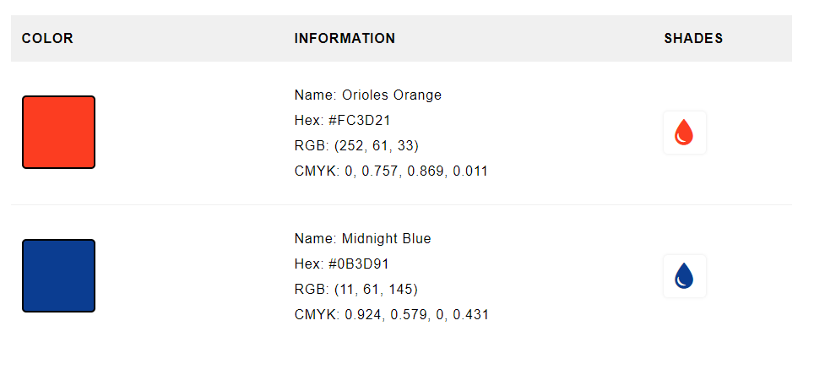
NASA Colors

Slide 52
Progress Trackers

